Slide 1
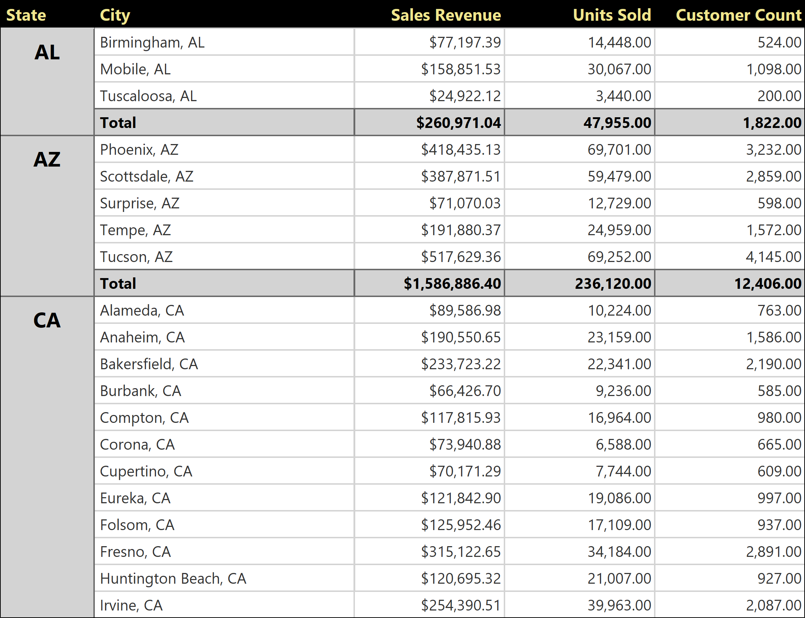
Customer Sales By City
Published 11/16/2021
Page 1 of 11

Slide 2
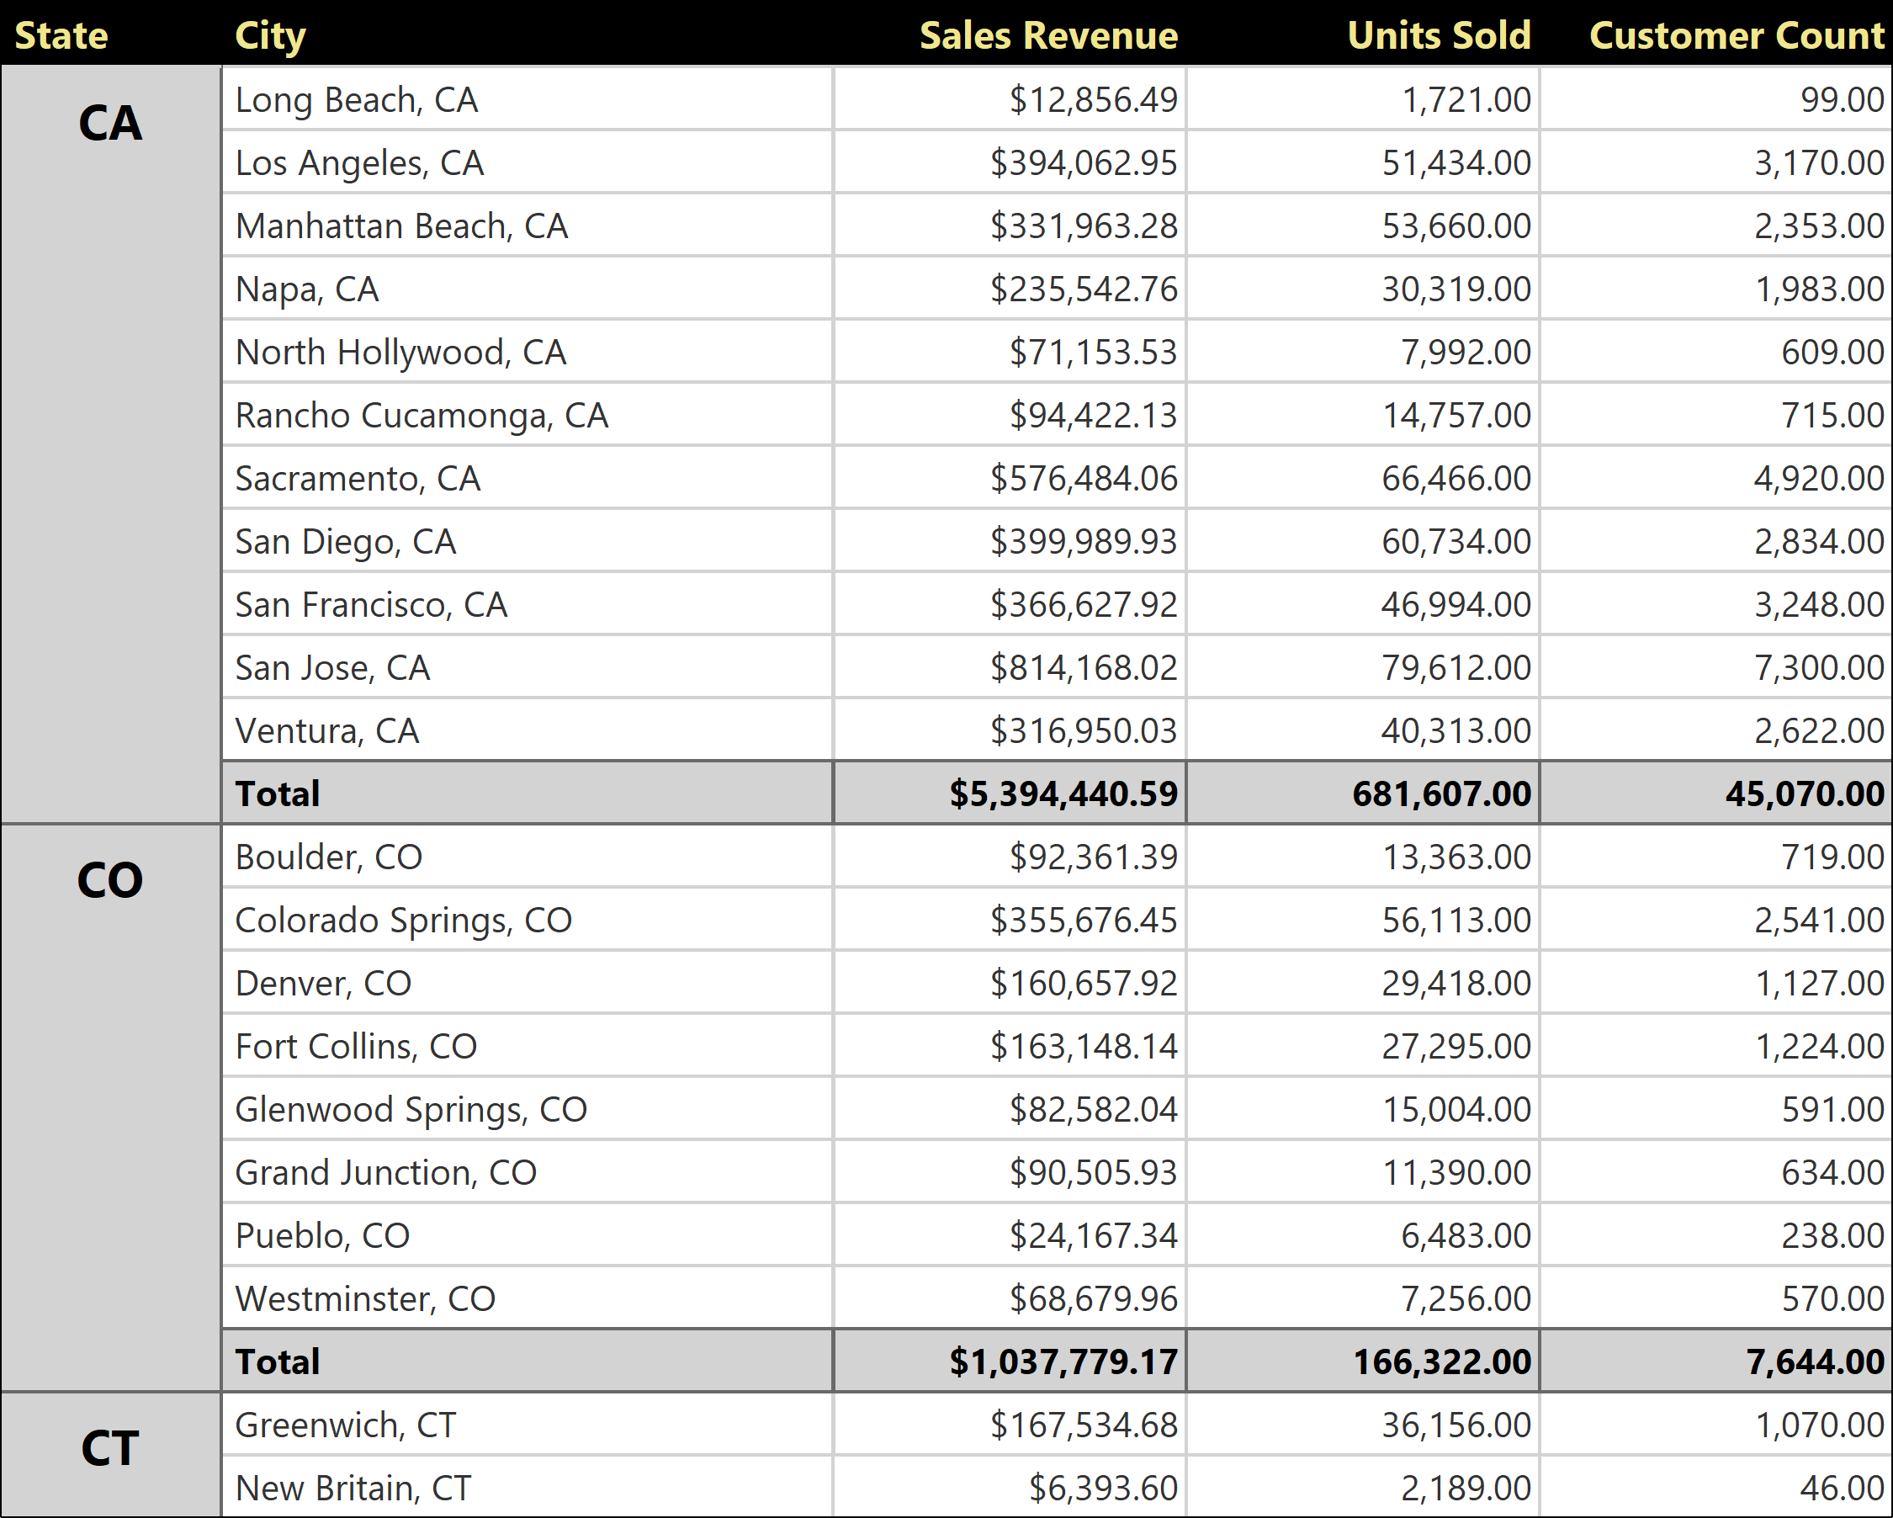
Published 11/16/2021
Page 2 of 11

Slide 3
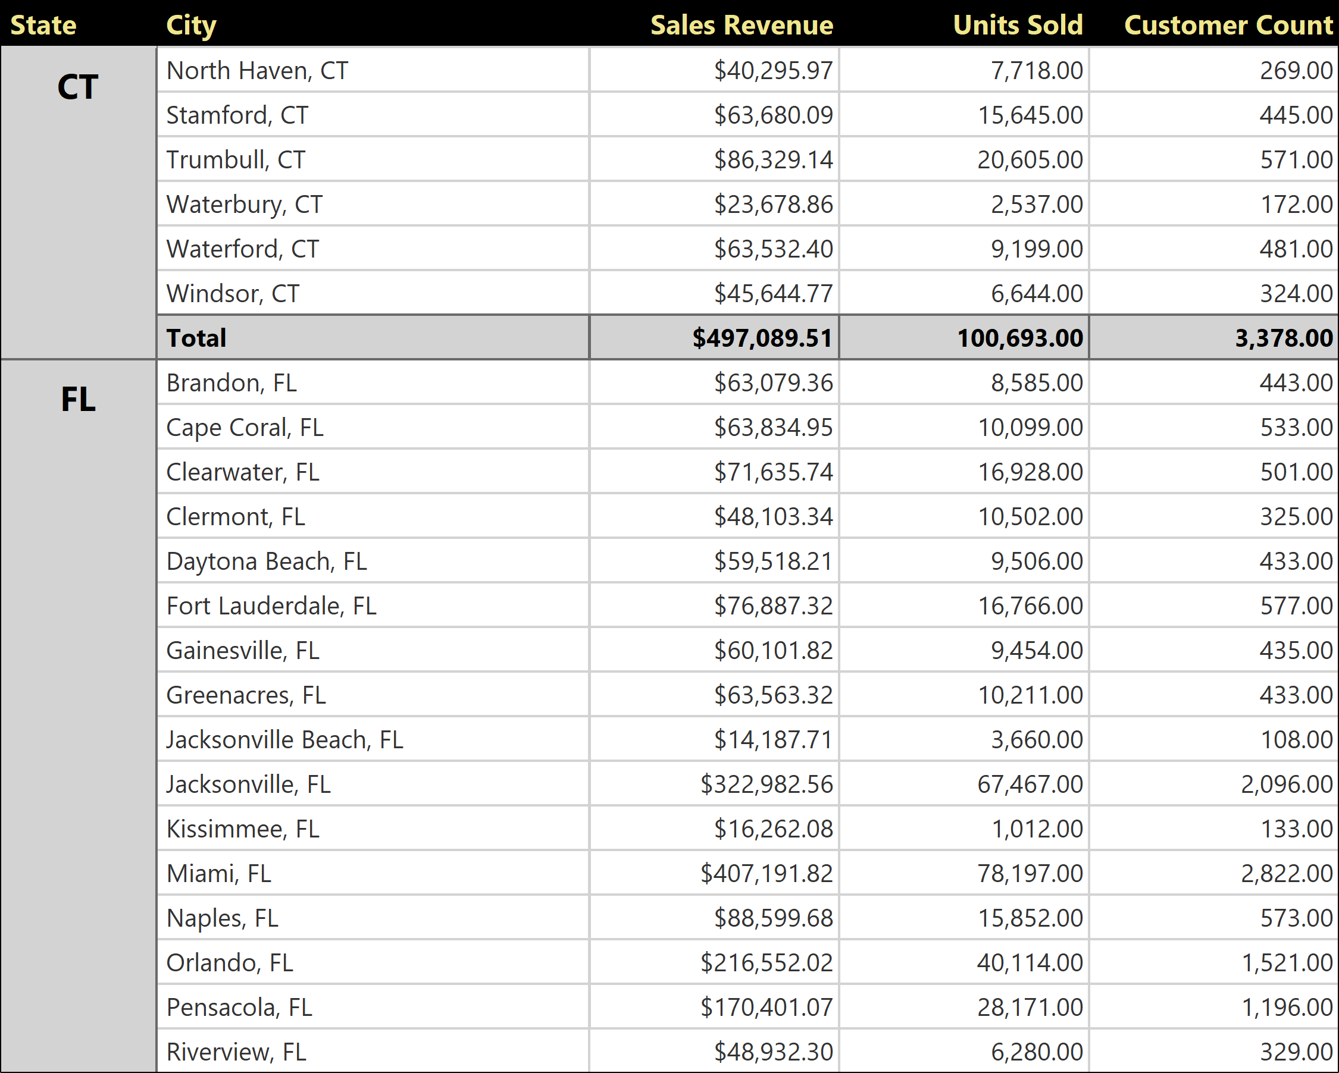
Published 11/16/2021
Page 3 of 11

Slide 4
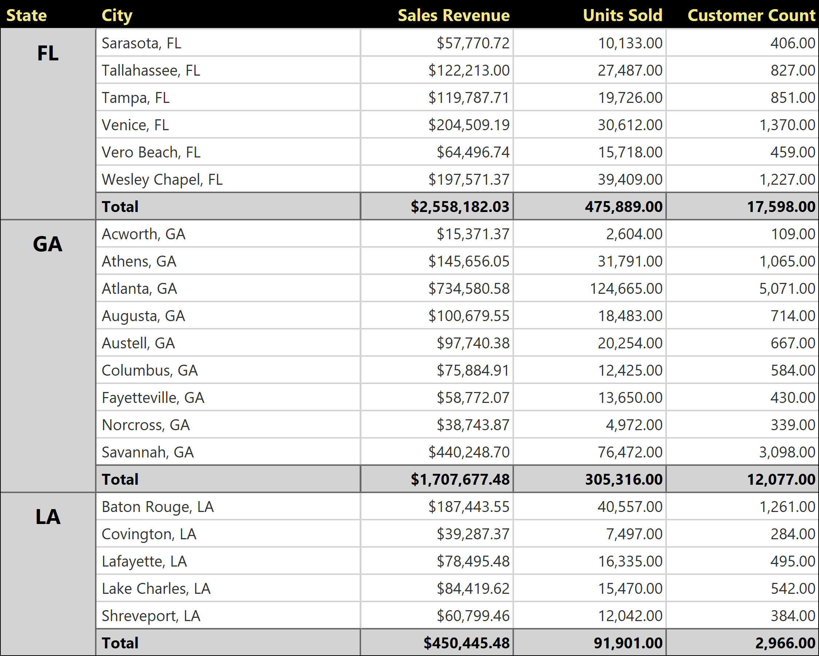
Published 11/16/2021
Page 4 of 11

Slide 5
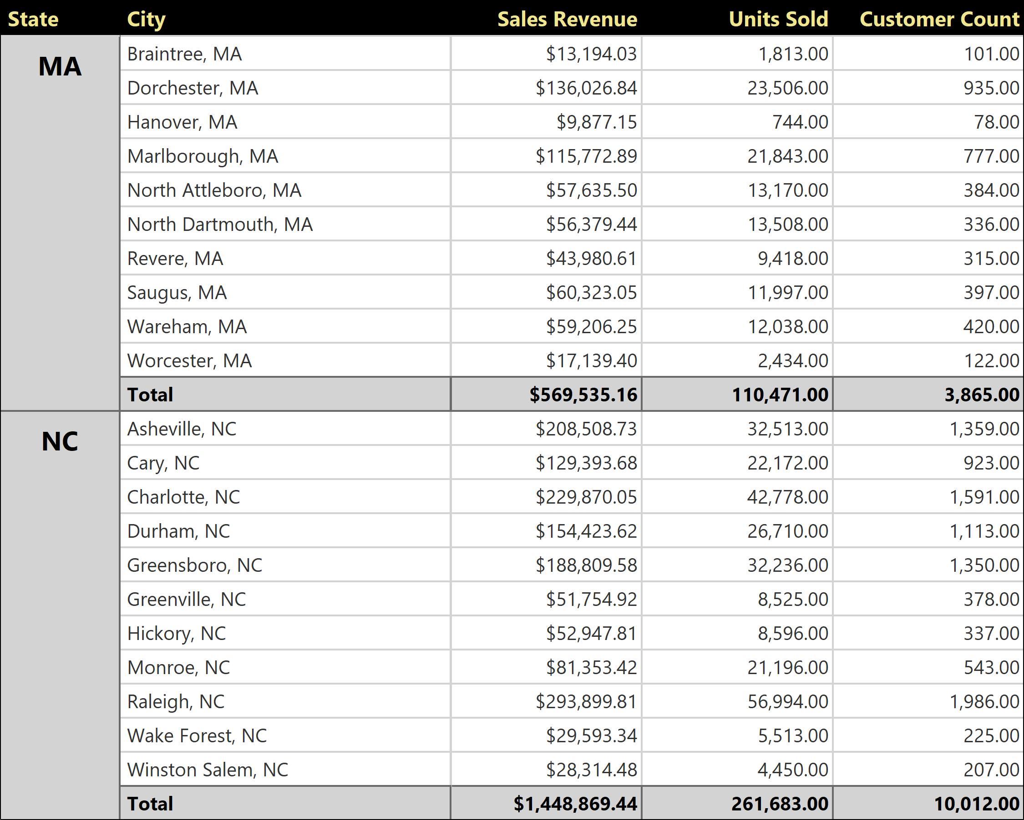
Published 11/16/2021
Page 5 of 11

Slide 6
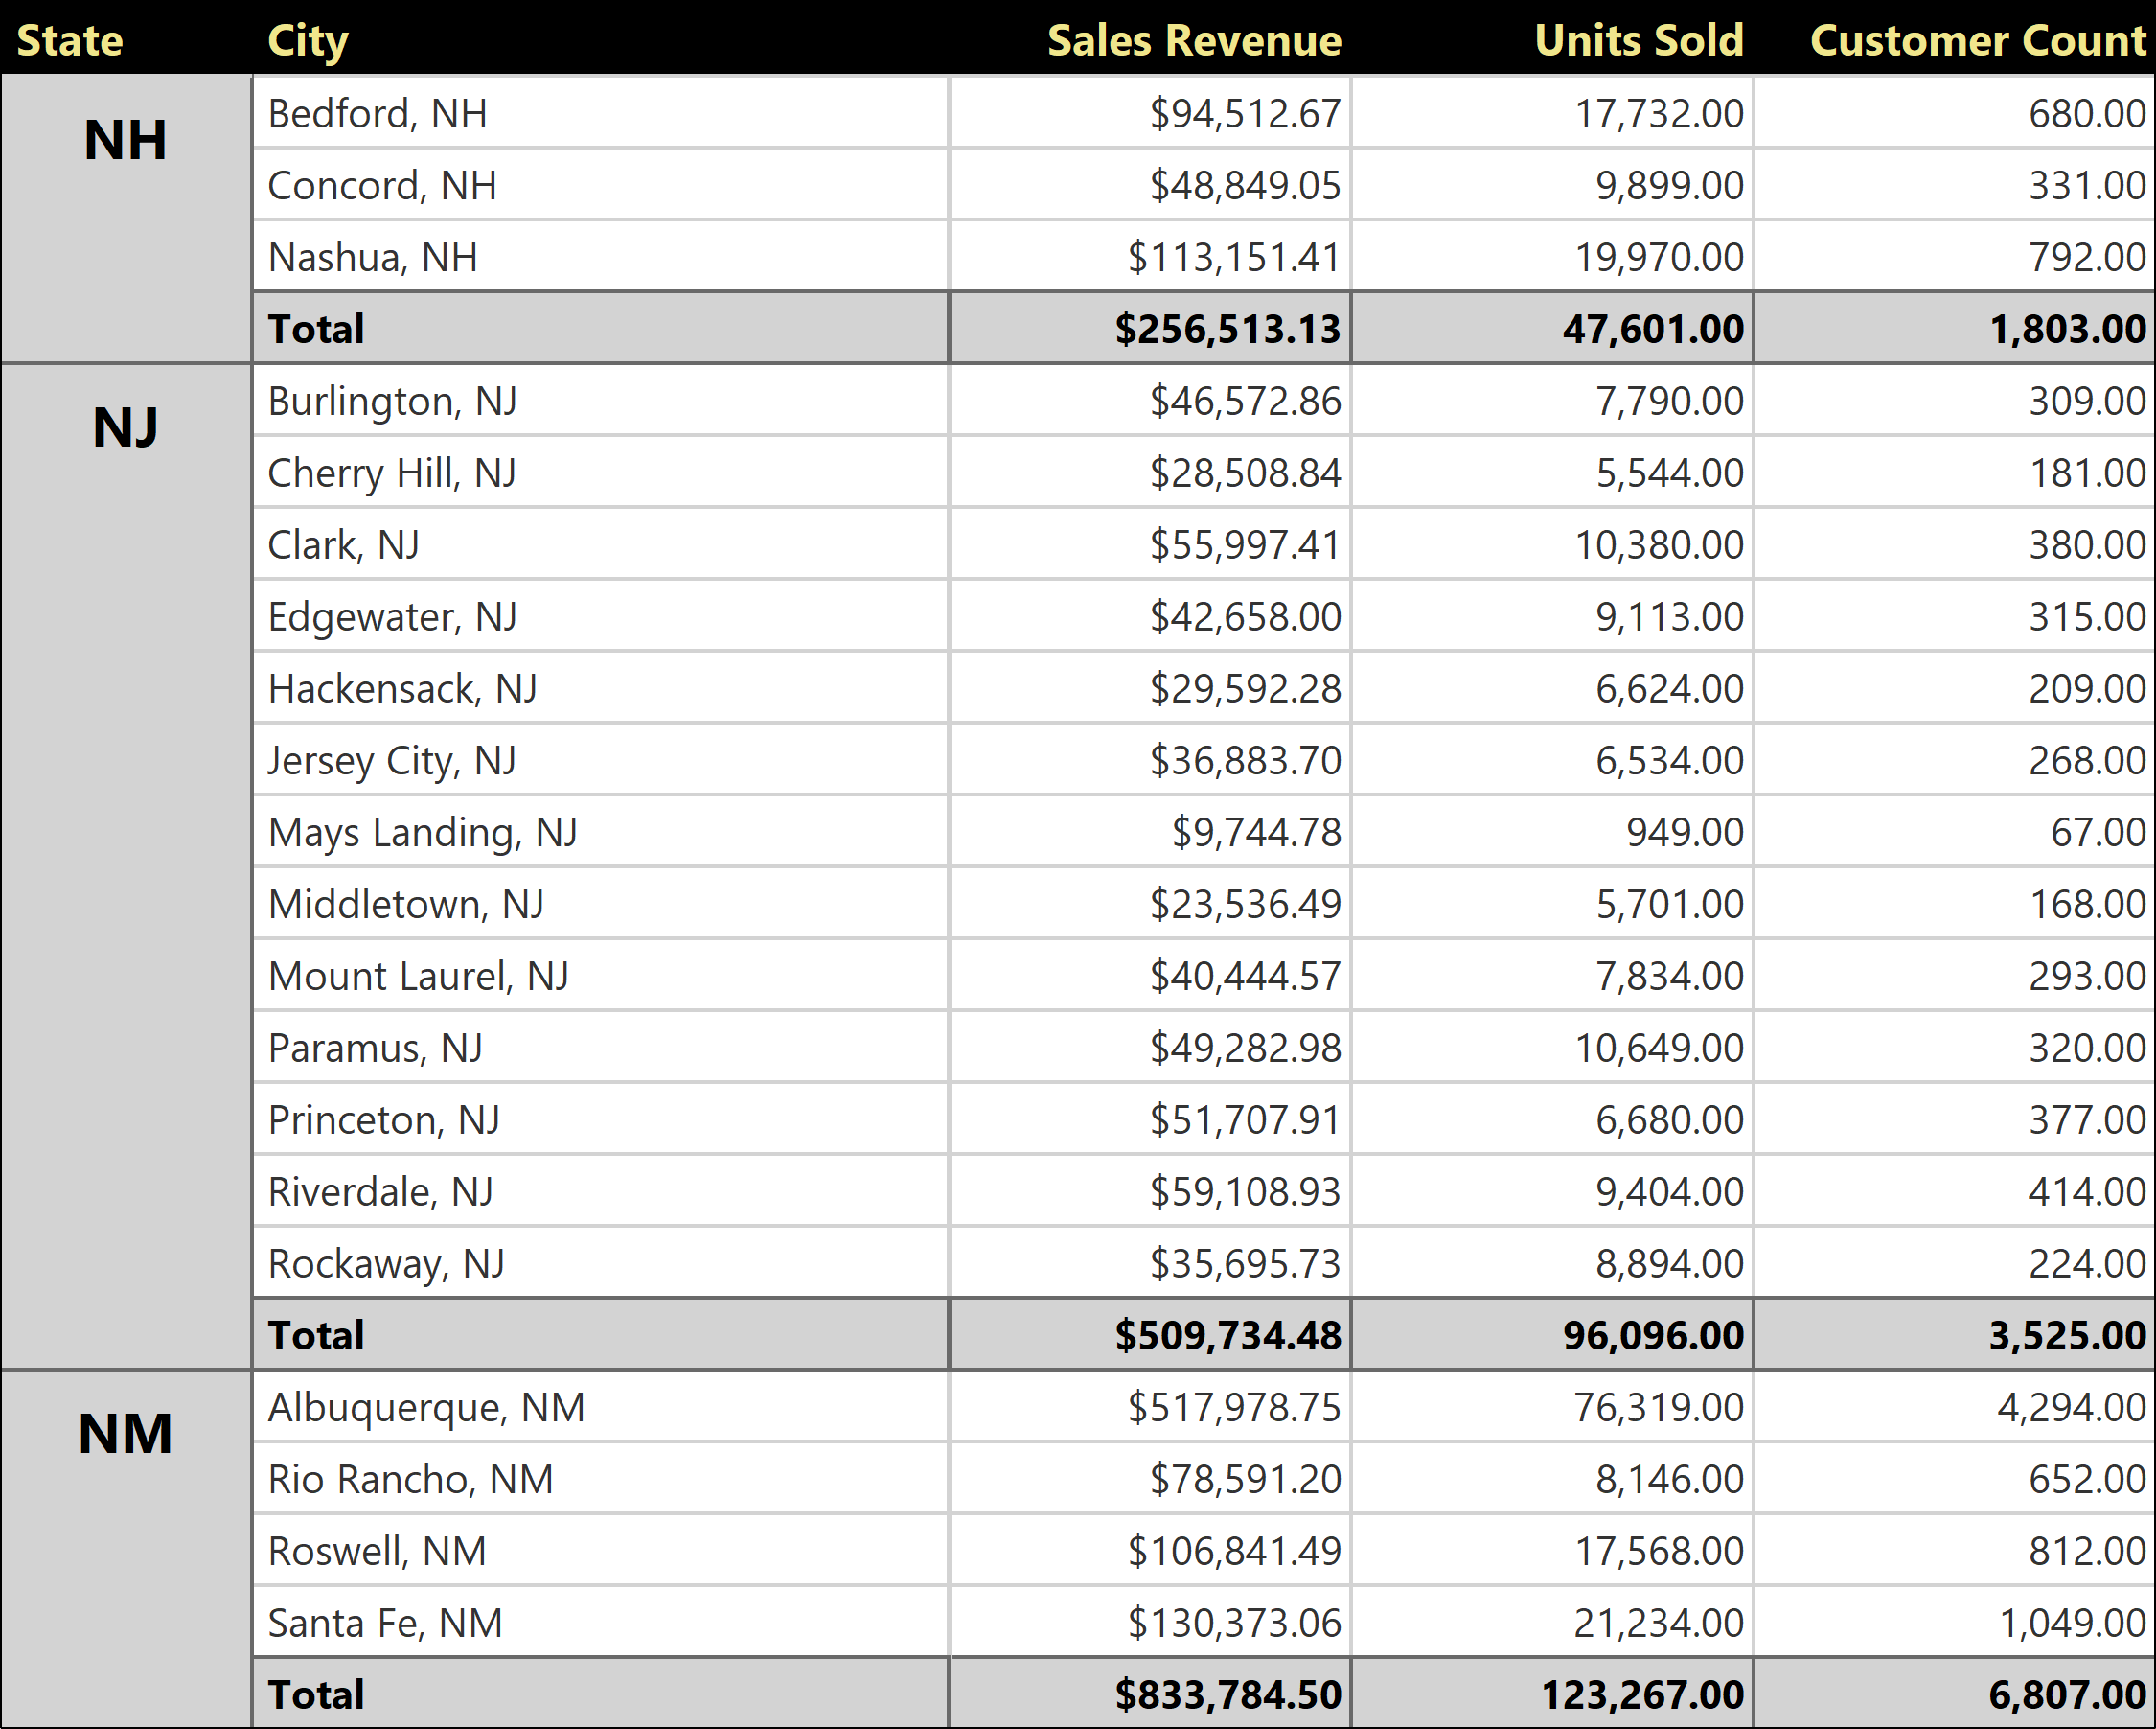
Published 11/16/2021
Page 6 of 11

Slide 7
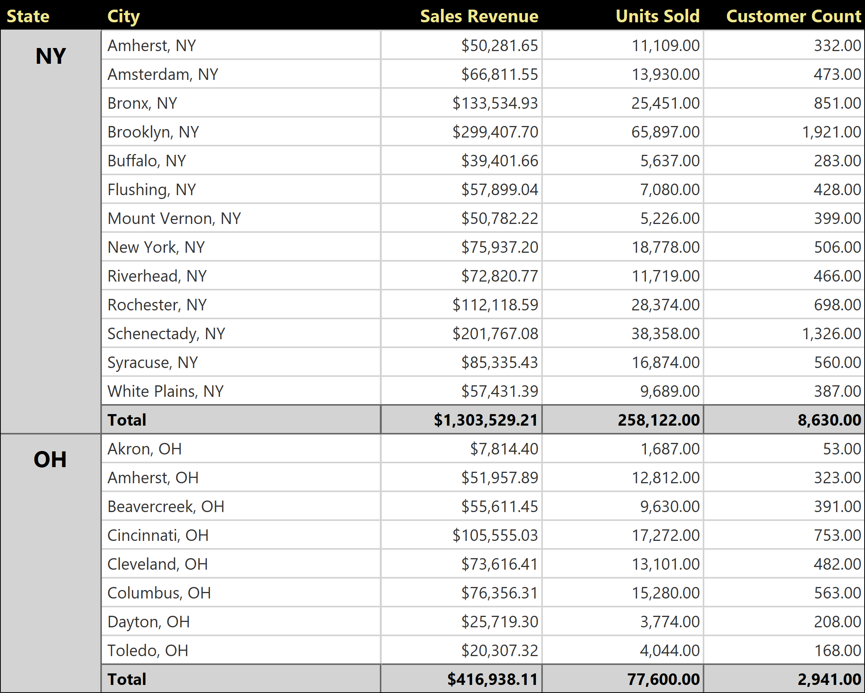
Published 11/16/2021
Page 7 of 11

Slide 8
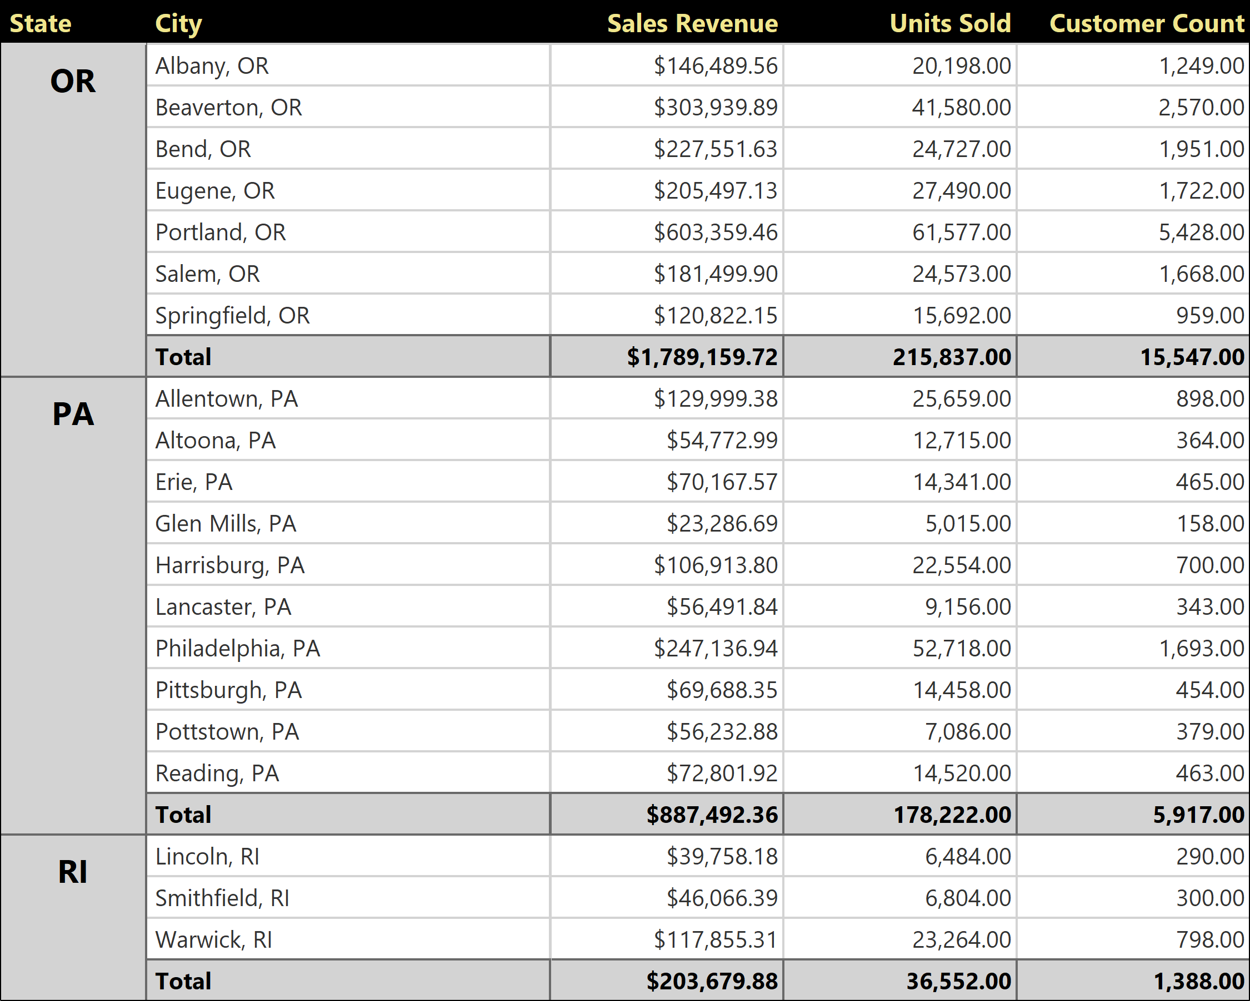
Published 11/16/2021
Page 8 of 11

Slide 9
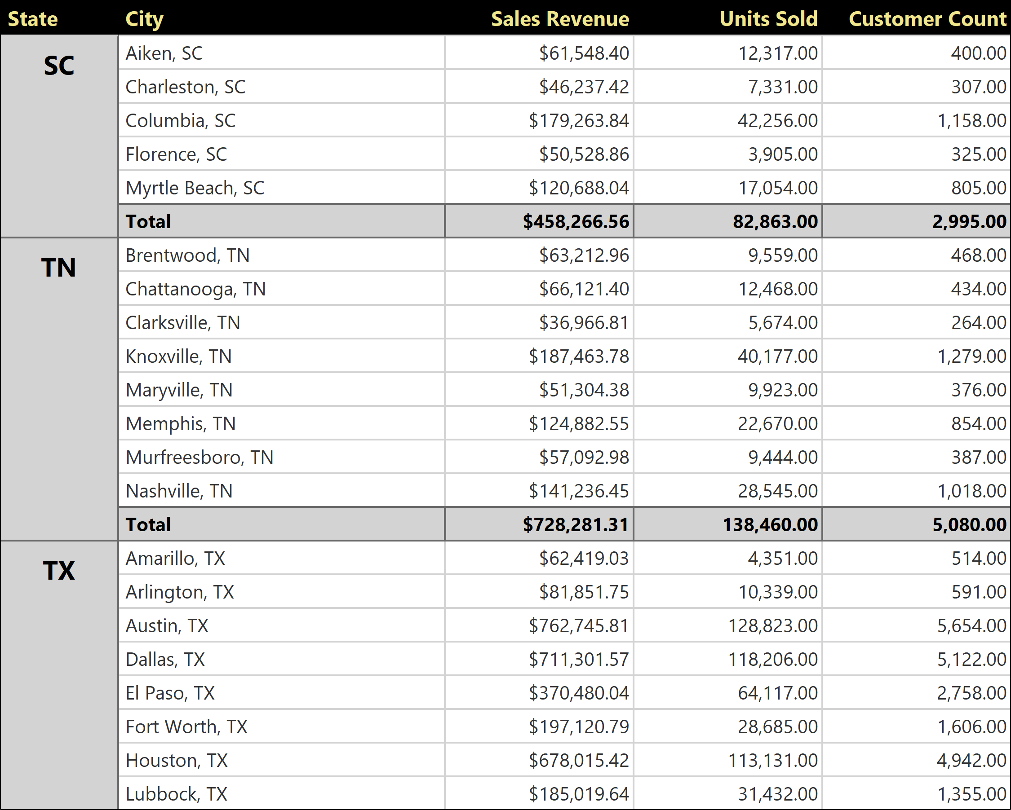
Published 11/16/2021
Page 9 of 11

Slide 10
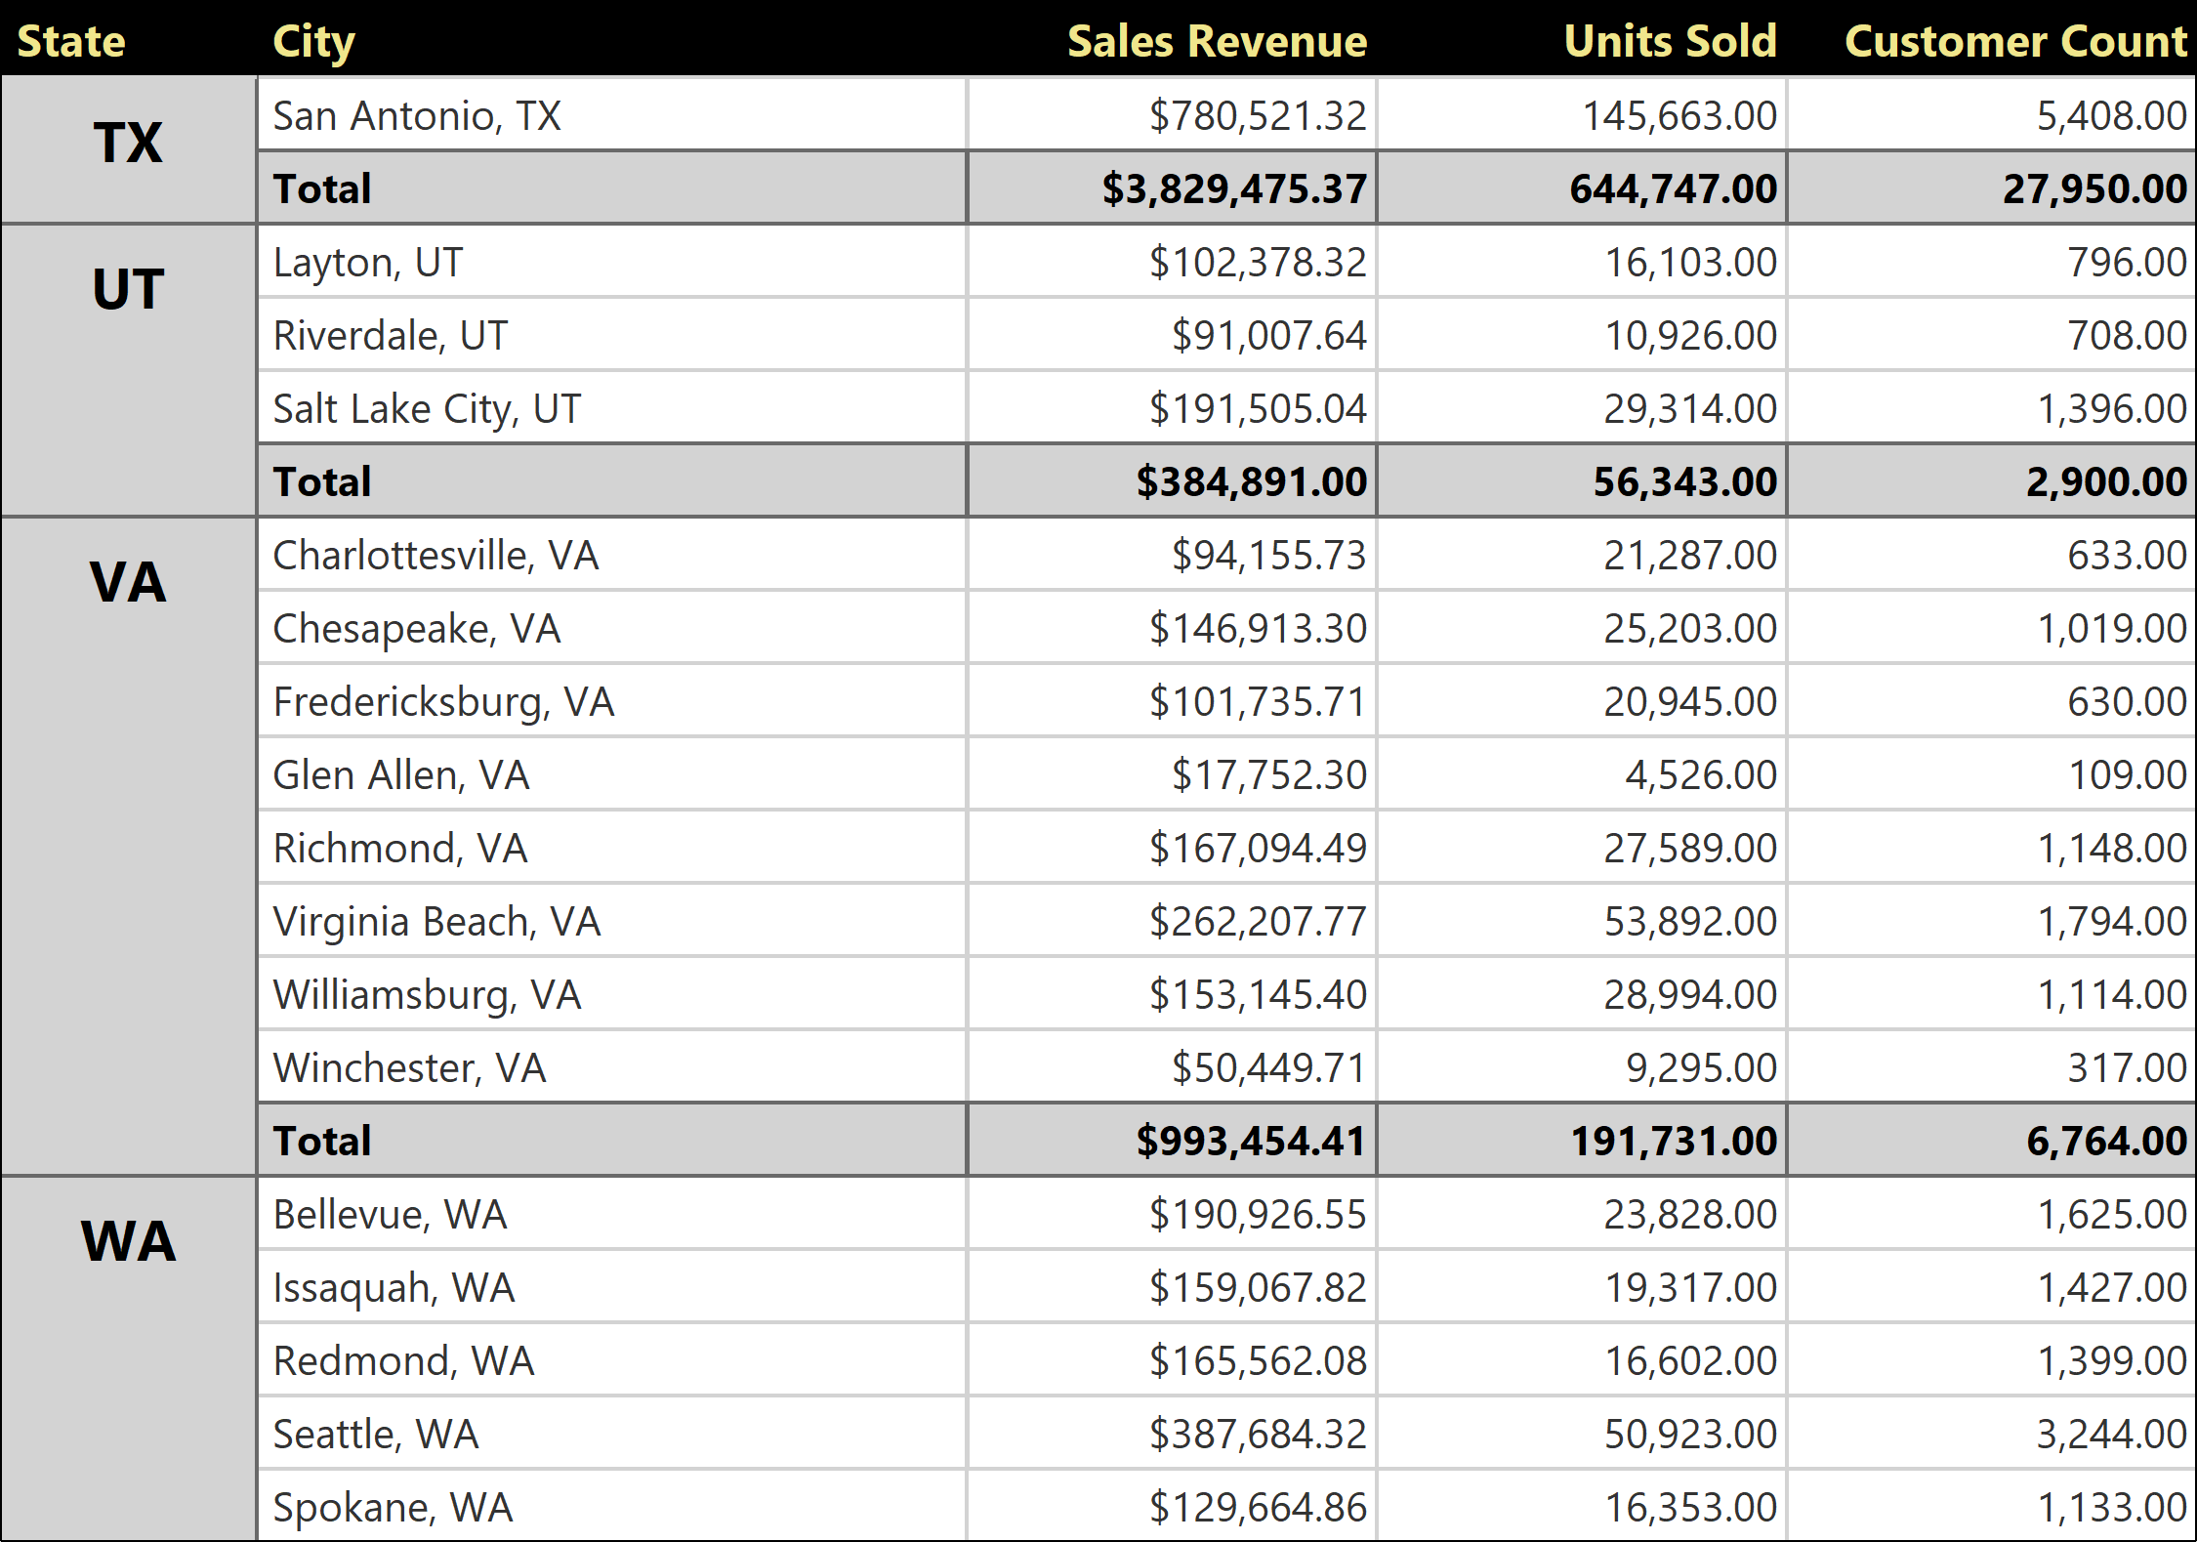
Published 11/16/2021
Page 10 of 11

Slide 11
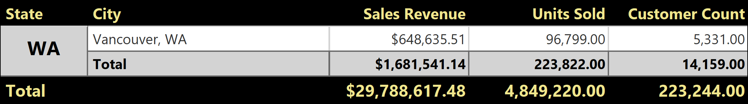
Published 11/16/2021
Page 11 of 11

